Slide 1

MODULE 3: PROGRAMMING FOR BIOLOGICAL DATA
Session 7: Diagnostic Accuracy
Sensitivity, Specificity, and ROC Curves
Instructor: Dr. Haogao Gu | Date: January 26, 2026

Slide 2








Learning Objectives
Confusion Matrix
Metrics
ROC & AUC
Optimization
Calculate Sensitivity, Specificity, PPV, and NPV.
Generate and interpret ROC curves and AUC values.
Find optimal cutoffs using the pROC package.
Understand components: TP, FP, TN, FN.

Slide 3


Why Diagnostic Accuracy Matters
The Core Question
Risk of FN
"Is this patient positive or negative?"
Patient sent home while sick.
No test is perfect. We must quantify:
•
Missed cases (False Negatives): Can lead to delayed treatment and spread of disease.
Risk of FP
•
False alarms (False Positives): Can lead to unnecessary anxiety and overtreatment.
Healthy patient treated needlessly.

Slide 4

Part 1: The Confusion Matrix
Foundations of Diagnostic Testing

Slide 5

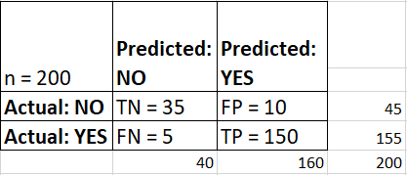
The Four Possible Outcomes
 | Actually Positive | Actually Negative
Test Positive | ✅ True Positive (TP) | ❌ False Positive (FP)
Test Negative | ❌ False Negative (FN) | ✅ True Negative (TN)

Slide 6
Example: Dengue Rapid Test
Tested 100 patients against gold standard PCR.
 | PCR+ (Disease) | PCR- (Healthy) | Total
Rapid Test + | 45 (TP) | 5 (FP) | 50
Rapid Test - | 8 (FN) | 42 (TN) | 50
Total | 53 | 47 | 100

Slide 7






Sensitivity (True Positive Rate)
Definition
Calculation
"How good is the test at finding POSITIVES?"
Using our Dengue Example:
Also known as Recall.
The test detects ~85% of true cases.

Slide 8



Clinical Meaning: SnNout
SnNout
Rule OUT
Sensitivity
If a highly sensitive test is NEGATIVE, you can be confident the patient does NOT have the disease.
Negative
out

Slide 9
Example: Dengue Rapid Test
Tested 100 patients against gold standard PCR.
 | PCR+ (Disease) | PCR- (Healthy) | Total
Rapid Test + | 45 (TP) | 5 (FP) | 50
Rapid Test - | 8 (FN) | 42 (TN) | 50
Total | 53 | 47 | 100

Slide 10




Specificity (True Negative Rate)
Definition
Calculation
"How good is the test at identifying NEGATIVES?"
Using our Dengue Example:
The test correctly identifies ~89% of healthy people.

Slide 11

Clinical Meaning: SpPin
SpPin
Rule IN
Specificity
If a highly specific test is POSITIVE, you can be confident the patient HAS the disease.
False Positive low, then should be True positive.
Positive
in

Slide 12
Example: Dengue Rapid Test
Tested 100 patients against gold standard PCR.
 | PCR+ (Disease) | PCR- (Healthy) | Total
Rapid Test + | 45 (TP) | 5 (FP) | 50
Rapid Test - | 8 (FN) | 42 (TN) | 50
Total | 53 | 47 | 100

Slide 13



Predictive Values
Crucial Note: These values depend heavily on disease prevalence.
PPV (Positive Predictive Value)
NPV (Negative Predictive Value)
If test is +, how likely is disease?
If test is -, how likely is healthy?
Example: 90%
Example: 84%

Slide 14
The Effect of Prevalence
Same test (Sens 90%, Spec 90%), different populations:
Scenario | Prevalence | PPV (Confidence in +) | NPV (Confidence in -)
Screening | 1% | 8.3% (Very Low!) | 99.9% (High)
Hospital | 50% | 90.0% (Moderate) | 90.0% (Moderate)
Epidemic | 90% | 98.8% (High) | 52.9% (Low)

Slide 15
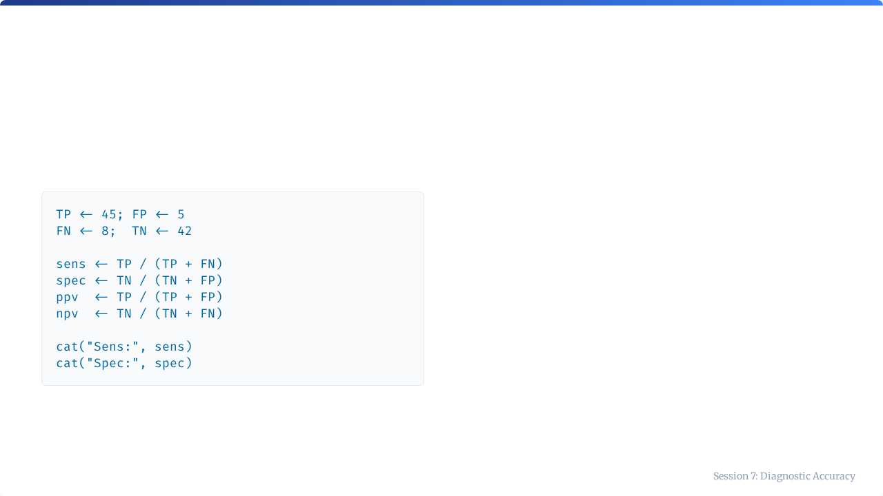
Calculating Metrics in R
Manual Verification
It is often easiest to define the variables directly from your confusion matrix (table) output and run the formulas.
This ensures you don't mix up the denominators.

Slide 16
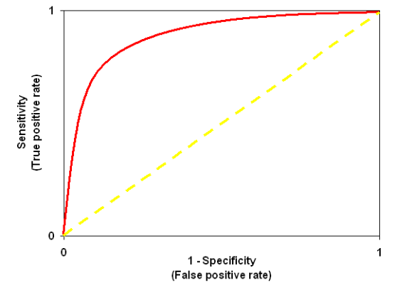
Sensitivity-Specificity Trade-off
You can't maximize both!
Diagnostic tests usually output a continuous value (e.g., OD, concentration).
Moving the cutoff:
•
Lower Cutoff: Catch more disease (↑ Sens) but more false alarms (↓ Spec).
•
Higher Cutoff: Miss more disease (↓ Sens) but fewer false alarms (↑ Spec).

Slide 17






Clinical Priorities
Screening
Confirmation
Blood Bank
Priority: High Sensitivity
Priority: High Specificity
Priority: Both High
Don't miss any cases. Accept some false positives.
Avoid false diagnosis. Be sure before treating.
Safety critical. Cannot miss HIV/HepC, cannot waste blood.

Slide 18

Part 2: ROC Analysis
Receiver Operating Characteristic

Slide 19
What is an ROC Curve?
A graph that visualizes the performance of a test across all possible cutoffs.
The Axes
•
Y-Axis: Sensitivity (True Positive Rate)
•
X-Axis: 1 - Specificity (False Positive Rate)

Slide 20
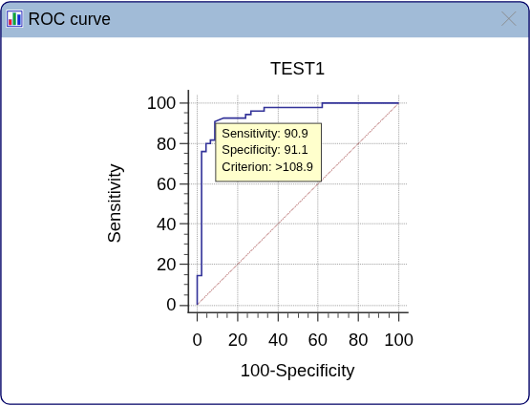
Reading an ROC Curve
Key Landmarks
•
Upper Left Corner: The "Perfect" Test (100% Sens, 100% Spec).
•
Diagonal Line: Random Guessing (no better than a coin flip).
•
The Curve: The closer it bows toward the upper left, the better the test.

Slide 21


AUC: Area Under the Curve
Definition
Interpretation
A single number that summarizes the overall discrimination ability of the test.
AUC | Meaning
0.5 | No discrimination (Random)
0.7-0.8 | Acceptable
0.8-0.9 | Excellent
>0.9 | Outstanding
Probability that a random positive has a higher score than a random negative.

Slide 22
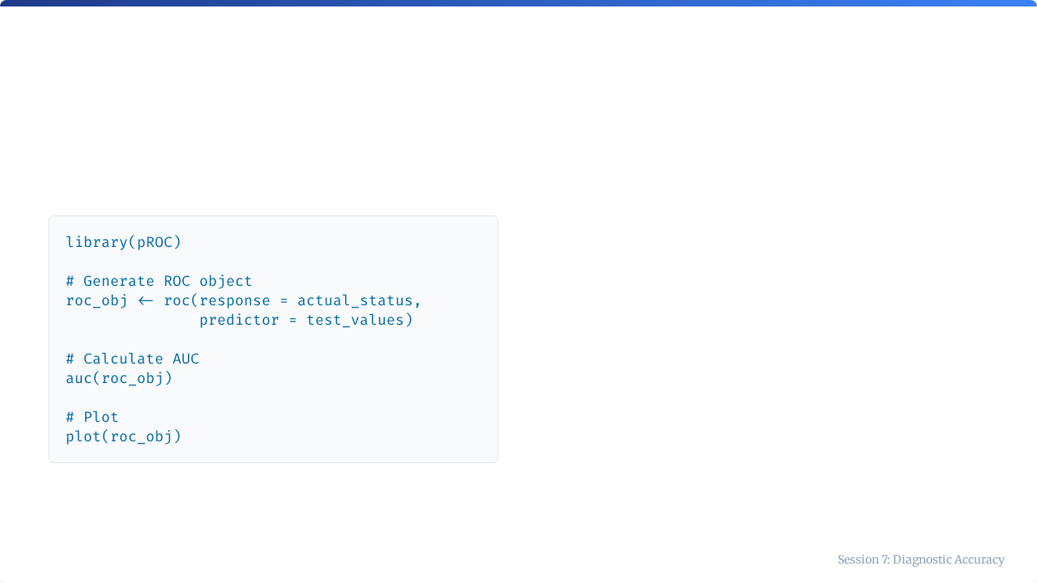
Using the pROC Package
Workflow
1.
Load pROC.
2.
Create ROC object using truth vector and test result vector.
3.
Extract AUC.
4.
Visualize.

Slide 23

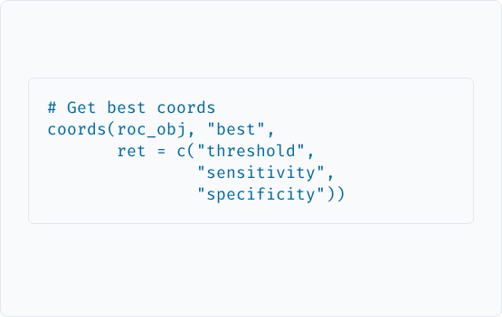
Finding the Optimal Cutoff
Youden Index
R Code
Method to find the "best balance" between sensitivity and specificity.
J = Sensitivity + Specificity - 1
Maximizes distance from the diagonal line.

Slide 24
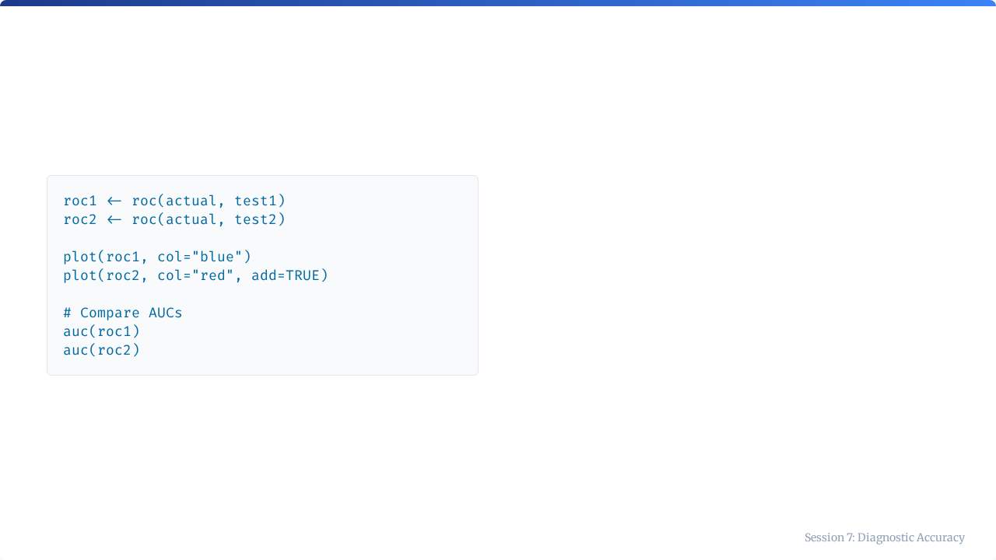

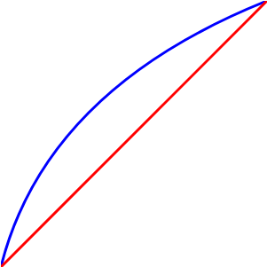
Comparing Two Tests
Test 1
Test 2
When curves overlap, AUC helps decide the overall winner. If curves cross, one test might be better for high sensitivity while the other is better for high specificity.

Slide 25


Key Takeaways
•
Confusion Matrix: The foundation (TP, FP, FN, TN).
•
ROC Curve: Visualizes performance across all cutoffs.
•
Sensitivity: Finding positives (Rule OUT).
•
AUC: The grade of the test (0.5 to 1.0).
•
Specificity: Finding negatives (Rule IN).
•
Optimal Cutoff: Depends on clinical context (Screening vs Confirmation).

Slide 26

Tutorial 7
Optimizing the Cutoff
Open your R environment

Slide 27
Tutorial 7: Optimizing the Cutoff
ROC Analysis in Practice

Slide 28

Your Scenario
Lab Context
Your lab is evaluating a new dengue ELISA assay.
•
Data: 40 patient samples.
•
Measurements: ELISA OD values (higher = more positive).
•
Gold Standard: PCR results (0/1).
Goal: Find the optimal OD cutoff for reporting.

Slide 29



Tutorial Steps
1
2
3
4
Load
ROC
Plot
Cutoff
Load the data frame.
Generate ROC object.
Visualize curve & AUC.
Find Youden Index.

Slide 30
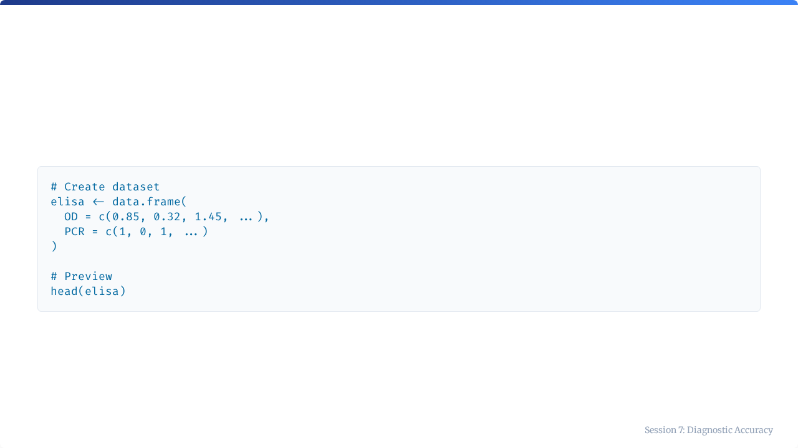
Step 1: Load Data
Ensure your data has a predictor column (OD) and a binary response column (PCR).

Slide 31
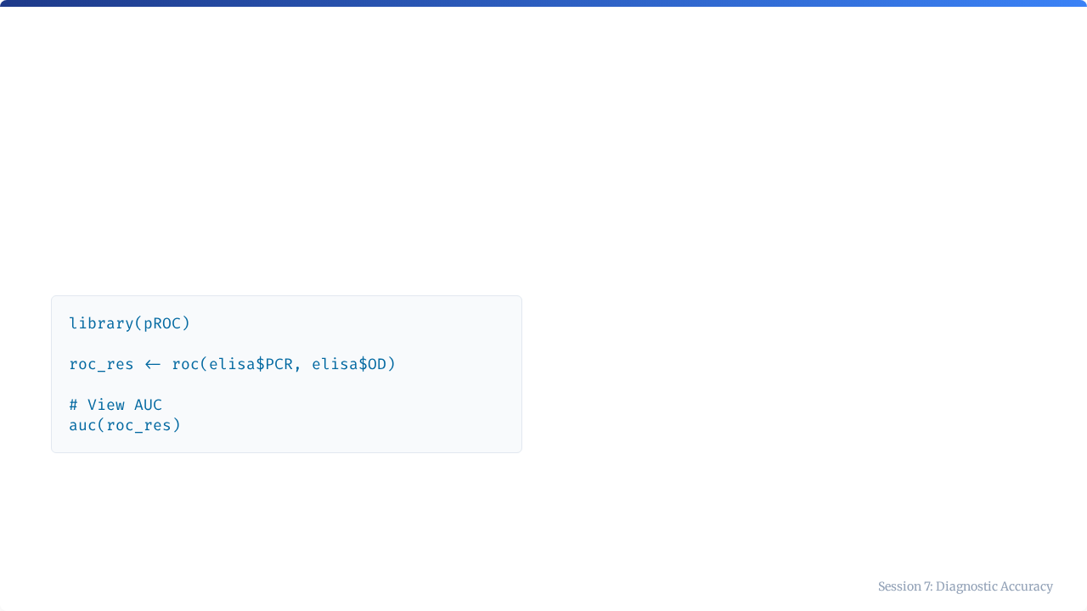
Step 2: Generate ROC
Code
Note
The roc() function needs:
1.
Response: The truth (PCR).
2.
Predictor: The test value (OD).

Slide 32
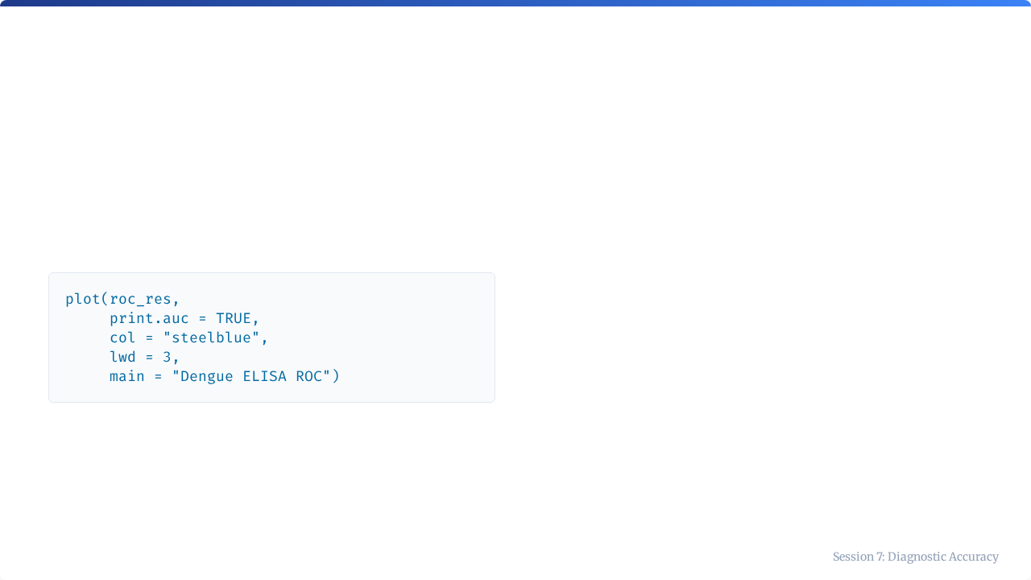
Step 3: Plot ROC
Checklist
•
Is the curve above the diagonal?
•
Is the AUC > 0.8?
•
Does it look smooth or jagged? (Small N = jagged)

Slide 33
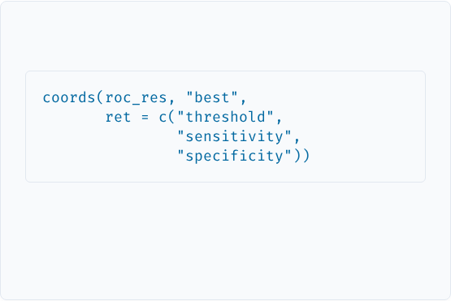

Step 4: Find Optimal Cutoff
Code
Output Interpretation
R will output the threshold value that maximizes Sensitivity + Specificity.
Example Output: Threshold: 0.65 Sens: 0.95 Spec: 0.90

Slide 34

Step 5: Final Recommendation
Based on your analysis, you report to the lab director.
"We recommend an OD cutoff of 0.65. This provides a sensitivity of 95% and specificity of 90%, optimizing our ability to detect Dengue while minimizing false positives."
Next Steps
Proceed to Assessment 2 to test your knowledge!

Slide 35

Session 7 Complete
You are now ready for Assessment 2.

